Slide 1
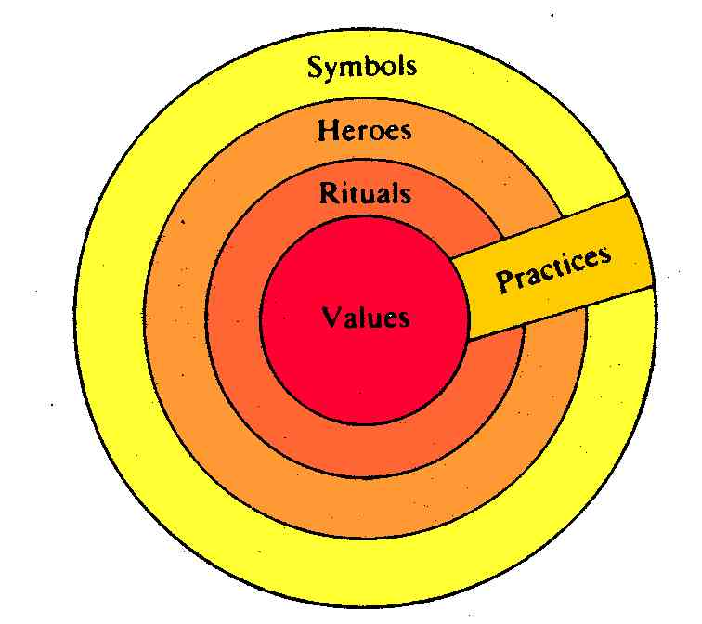
Hofstede’s cultural model
The Onion Model of Culture (Hofstede, 1991)

Slide 2
Hofstede’s 6-D model
The four core dimensions are power distance, individualism versus collectivism, masculinity versus femininity and uncertainty avoidance.
Partly in response to the criticisms mentioned above, a fifth dimension focused on long and short term time orientation based initially on a survey developed with Chinese employees was later added.
In 2010 a sixth dimension was added to the model, Indulgence versus Restraint.

Slide 3
Power Distance
Power Distance Index (PDI) is the extent to which the less powerful members of organizations and institutions (like the family) accept and expect that power is distributed unequally.
This represents inequality (more versus less), but defined from below, not from above. It suggests that a society's level of inequality is endorsed by the followers as much as by the leaders.
Power and inequality, of course, are extremely fundamental facts of any society and anybody with some international experience will be aware that 'all societies are unequal, but some are more unequal than others'.

Slide 4
Power distance
A High Power Distance ranking indicates that inequalities of power and wealth have been allowed to grow within the society. These societies are more likely to follow a caste system that does not allow significant upward mobility of its citizens.
A Low Power Distance ranking indicates the society de-emphasizes the differences between citizen's power and wealth. In these societies equality and opportunity for everyone is stressed.

Slide 5
Small power distance | Large power distance
Inequalities among people should be minimized | Inequalities among people are both expected and desired
There should be, and there is to some extent, interdependence between less and more powerful people | Less powerful people should be dependent on the more powerful; in practice, less powerful people are polarized between dependence and counterdependence
Parents treat children as equals | Parents teach children obedience
Children treat parents as equals | Children treat parents with respect
Teachers expect initiatives from students in class | Teachers are expected to take all initiatives in class
Teachers are experts who transfer impersonal truths | Teachers are gurus who transfer personal wisdom
Students treat teachers as equals | Students treat teachers with respect

Slide 6
Small power distance | Large power distance
More educated persons hold less authoritarian values than less educated persons | Both more and less educated persons show almost equally authoritarian values
Hierarchy in organizations means an inequality of roles, established for convenience | Hierarchy in organizations reflects the existential inequality between higher-ups and lower-downs
Decentralization is popular | Centralization is popular
Narrow salary range between top and bottom of organization | Wide salary range between top and bottom of organization
Subordinates expect to be consulted | Subordinates expect to be told what to do
The ideal boss is a resourceful democrat | The ideal boss is a benevolent autocrat or good father
Privileges and status symbols are frowned upon | Privileges and status symbols for managers are both expected and popular

Slide 7
Individualism
Individualism (IDV) on the one side versus its opposite, collectivism, that is the degree to which individuals are integrated into groups.
On the individualist side we find societies in which the ties between individuals are loose: everyone is expected to look after him/herself and his/her immediate family.
On the collectivist side, we find societies in which people from birth onwards are integrated into strong, cohesive in-groups, often extended families (with uncles, aunts and grandparents) which continue protecting them in exchange for unquestioning loyalty.
The word 'collectivism' in this sense has no political meaning: it refers to the group, not to the state. Again, the issue addressed by this dimension is an extremely fundamental one, regarding all societies in the world.

Slide 8
Individualism
A High Individualism ranking indicates that individuality and individual rights are paramount within the society. Individuals in these societies may tend to form a larger number of looser relationships.
A Low Individualism ranking typifies societies of a more collectivist nature with close ties between individuals. These cultures reinforce extended families and collectives where everyone takes responsibility for fellow members of their group.

Slide 9
Collectivist | Individualist
People are born into extended families or other ingroups which continue to protect them in exchange for loyalty | Everyone grows up to look after him/ herself and his/her immediate (nuclear) family only
Identity is based in the social network to which one belongs | Identity is based in the individual
Children learn to think in terms of 'we' | Children learn to think in terms of ‘I’
Harmony should always be maintained and direct confrontations avoided | Speaking one's mind is a characteristic of an honest person
High-context communication | Low-context communication

Slide 10
Collectivist | Individualist
Trespassing leads to shame and loss of face for self and group | Trespassing leads to guilt and loss of self-respect
Purpose of education is learning how to do | Purpose of education is learning how to learn
Diplomas provide entry to higher status groups | Diplomas increase economic worth and/or self-respect
Relationship employer-employee is perceived in moral terms, like a family link | Relationship employer-employee is a contract supposed to be based on mutual advantage
Hiring and promotion decisions take employees' ingroup into account | Hiring and promotion decisions are supposed to be based on skills and rules only
Management is management of groups | Management is management of individuals
Relationship prevails over task | Task prevails over relationship

Slide 11
Masculinity
Masculinity (MAS) versus its opposite, femininity, refers to the distribution of roles between the genders which is another fundamental issue for any society to which a range of solutions are found.
The IBM studies revealed that
(a) women's values differ less among societies than men's values;
(b) men's values from one country to another contain a dimension from very assertive and competitive and maximally different from women's values on the one side, to modest and caring and similar to women's values on the other.
The assertive pole has been called 'masculine' and the modest, caring pole 'feminine'. The women in feminine countries have the same modest, caring values as the men; in the masculine countries they are somewhat assertive and competitive, but not as much as the men, so that these countries show a gap between men's values and women's values.

Slide 12
Masculinity
A High Masculinity ranking indicates the country experiences a high degree of gender differentiation. In these cultures, males dominate a significant portion of the society and power structure, with females being controlled by male domination.
A Low Masculinity ranking indicates the country has a low level of differentiation and discrimination between genders. In these cultures, females are treated equally to males in all aspects of the society.

Slide 13
Feminine | Masculine
Dominant values in society are caring for others and preservation | Dominant values in society are material success and progress
People and warm relationships are important | Money and things are important
Everybody is supposed to be modest | Men are supposed to be assertive, ambitious, and tough
Both men and women are allowed to be tender and to be concerned with relationships | Women are supposed to be tender and to take care of relationships

Slide 14
Feminine | Masculine
In the family, both fathers and mothers deal with facts and feelings | In the family, fathers deal with facts and mothers with feelings
Both boys and girls are allowed to cry but neither should fight | Girls cry, boys don't; boys should fight back when attacked, girls shouldn't fight
Sympathy for the weak | Sympathy for the strong
Average student is the norm | Best student is the norm
Failing in school is a minor accident | Failing in school is a disaster
Friendliness in teachers appreciated | Brilliance in teachers appreciated

Slide 15
Feminine | Masculine
Boys and girls study same subjects | Boys and girls study different subjects
Work in order to live | Live in order to work
Managers use intuition and strive for consensus | Managers expected to be decisive and assertive
Stress on equality, solidarity, and quality of work life | Stress on equity, competition among colleagues, and performance
Resolution of conflicts by compromise and negotiation | Resolution of conflicts by fighting them out

Slide 16
Uncertainty avoidance
Uncertainty Avoidance Index (UAI) deals with a society's tolerance for uncertainty and ambiguity; it ultimately refers to man's search for Truth. It indicates to what extent a culture programs its members to feel either uncomfortable or comfortable in unstructured situations. Unstructured situations are novel, unknown, surprising, different from usual.
Uncertainty avoiding cultures try to minimize the possibility of such situations by strict laws and rules, safety and security measures, and on the philosophical and religious level by a belief in absolute Truth; 'there can only be one Truth and we have it'. People in uncertainty avoiding countries are also more emotional, and motivated by inner nervous energy.

Slide 17
Uncertainty avoidance
The opposite type, uncertainty accepting cultures, are more tolerant of opinions different from what they are used to; they try to have as few rules as possible, and on the philosophical and religious level they are relativist and allow many currents to flow side by side. People within these cultures are more phlegmatic and contemplative, and not expected by their environment to express emotions.

Slide 18
Uncertainty avoidance
A High Uncertainty Avoidance ranking indicates the country has a low tolerance for uncertainty and ambiguity. This creates a rule-oriented society that institutes laws, rules, regulations, and controls in order to reduce the amount of uncertainty.
A Low Uncertainty Avoidance ranking indicates the country has less concern about ambiguity and uncertainty and has more tolerance for a variety of opinions. This is reflected in a society that is less rule-oriented, more readily accepts change, and takes more and greater risks.

Slide 19
Weak uncertainty avoidance | Strong uncertainty avoidance
Uncertainty is a normal feature of life and each day is accepted as it comes | The uncertainty inherent in life is felt as a continuous threat which must be fought
Low stress; subjective feeling of well-being | High stress; subjective feeling of anxiety
Aggression and emotions should not be shown | Aggression and emotions may at proper times and places be ventilated
Comfortable in ambiguous situations and with unfamiliar risks | Acceptance of familiar risks; fear of ambiguous situations and of unfamiliar risks
Lenient rules for children on what is dirty and taboo | Tight rules for children on what is dirty and taboo
What is different, is curious | What is different, is dangerous
Students comfortable with open-ended learning situations and concerned with good discussions | Students comfortable in structured learning situations and concerned with the right answers

Slide 20
Weak uncertainty avoidance | Strong uncertainty avoidance
Teachers may say 'I don't know' | Teachers supposed to have all the answers
There should not be more rules than is strictly necessary | Emotional need for rules, even if these will never work
Time is a framework for orientation | Time is money
Comfortable feeling when lazy; hard-working only when needed | Emotional need to be busy; inner urge to work hard
Precision and punctuality have to be learned | Precision and punctuality come naturally
Tolerance of deviant and innovative ideas and behaviour | Suppression of deviant ideas and behaviour; resistance to innovation
Motivation by achievement and esteem or belongingness | Motivation by security and esteem or belongingness

Slide 21
Long-term orientation
Long-Term Orientation (LTO) versus short-term orientation: this fifth dimension was found in a study among students in 23 countries around the world, using a questionnaire designed by Chinese scholars.
It can be said to deal with Virtue regardless of Truth. Values associated with Long Term Orientation are thrift and perseverance; values associated with Short Term Orientation are respect for tradition, fulfilling social obligations, and protecting one's 'face'. Both the positively and the negatively rated values of this dimension are found in the teachings of Confucius, the most influential Chinese philosopher who lived around 500 B.C.; however, the dimension also applies to countries without a Confucian heritage.

Slide 22
Long-term orientation
A High Long-Term Orientation ranking indicates the country prescribes to the values of long-term commitments and respect for tradition. This is thought to support a strong work ethic where long-term rewards are expected as a result of today's hard work. However, business may take longer to develop in this society, particularly for an "outsider".
A Low Long-Term Orientation ranking indicates the country does not reinforce the concept of long-term, traditional orientation. In this culture, change can occur more rapidly as long-term traditions and commitments do not become impediments to change.

Slide 23
Short-term orientation | Long-term orientation
Respect for traditions | Adaptation of traditions to a modern context
Respect for social and status obligations regardless of cost | Respect for social and status obligations within limits
Social pressure to 'keep up with the Joneses' even if it means overspending | Thrift, being sparing with resources
Small savings quote, little money for investment | Large savings quote, funds available for investment
Quick results expected | Perseverance towards slow results
Concern with 'face' | Willingness to subordinate oneself for a purpose
Concern with possessing the Truth | Concern with respecting the demands of Virtue

Slide 24
Indulgence vs restraint
Indulgence societies tend to allow relatively free gratification of natural human desires related to enjoying life and having fun whereas Restraint societies are more likely to believe that such gratification needs to be curbed and regulated by strict norms.

Slide 25
Indulgence vs restraint
Indulgent cultures will tend to focus more on individual happiness and well being, leisure time is more important and there is greater freedom and personal control.
This is in contrast with restrained cultures where positive emotions are less freely expressed and happiness, freedom and leisure are not given the same importance.

Slide 26
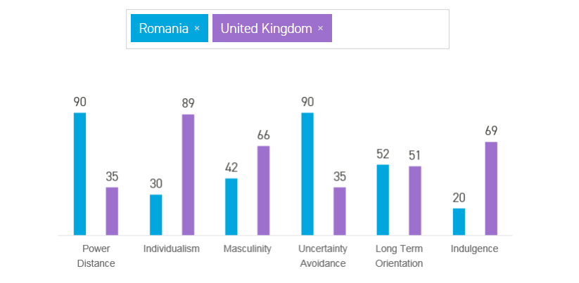
Great Britain vs Romania
https://www.hofstede-insights.com/product/compare-countries/

